Slide 1

Deep Learning and Machine Learning Techniques for Cyber Attacks Detection on IoMT Devices
Group Members:
Syed Sarib Naveed (BSCS2021-41)
Muhammad Usman Safder (BSCS2021-17)
SR

Slide 2
Research Objectives:
Utilize Comprehensive Datasets
Analyze Cyber Attack Patterns
Enhance Detection Accuracy
Profile Device Behaviors
Develop Robust Security Frameworks
Evaluate Model Performance
Explore Future Directions

Slide 3
Dataset Overview of CIC IoMT Dataset 2024
Dataset Summary:
Name: CIC IoMT Dataset 2024
Focus: Assessing IoMT device security in healthcare
Protocols: Wi-Fi, MQTT, Bluetooth
Devices: 40 IoMT devices (25 real, 15 simulated)
Attack Classes: DDoS, DoS, Recon, MQTT, Spoofing
Number of Attacks: 18
1
Dataset Features
2
Potential Challenges
3
Research Focus
Includes header length, protocol type, duration, rate, flags, and statistical measures
Dataset imbalance, feature selection, model complexity, and evolving threats
Accuracy of classification, significant features, model comparison, and feature selection impact

Slide 4
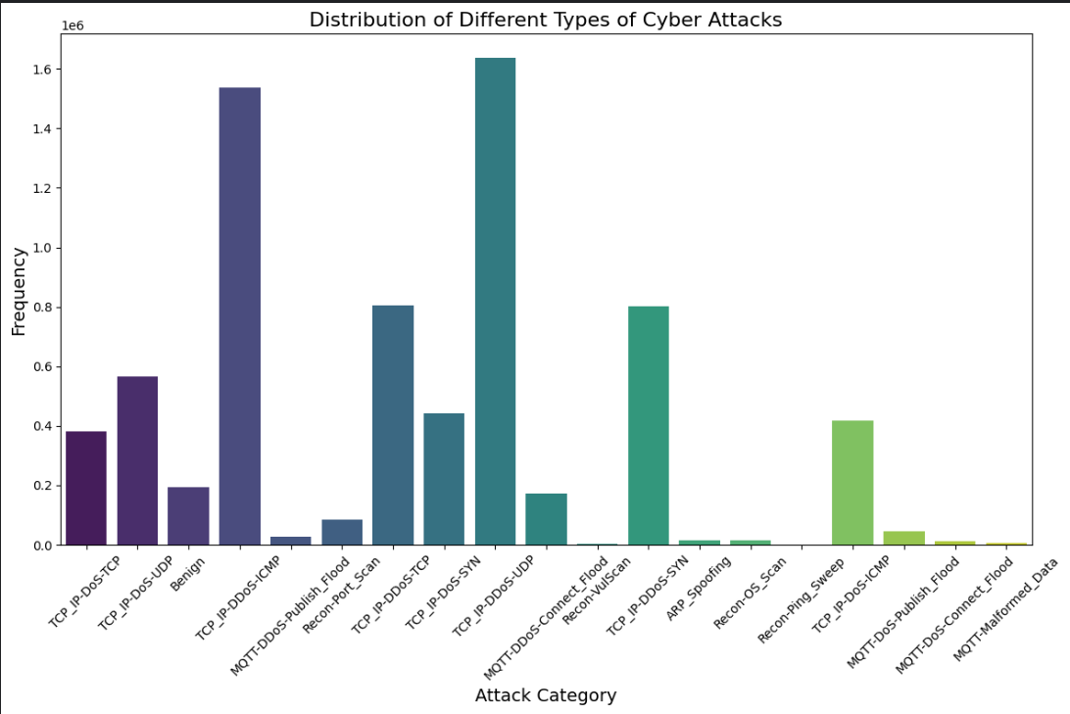
Dataset Distribution:

Slide 5
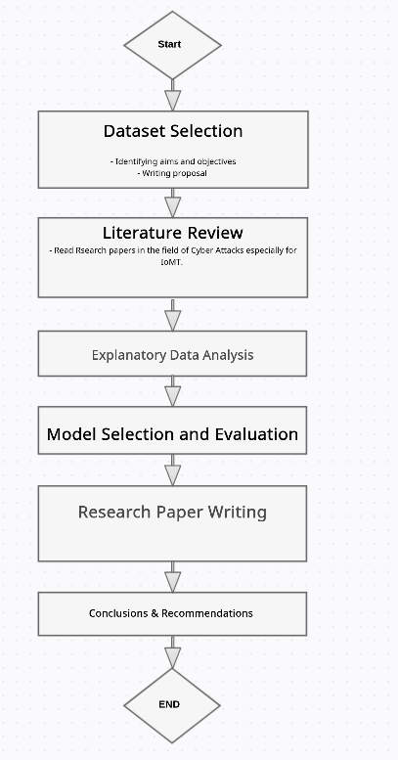
Research Flow Diagram:

Slide 6
Research Questions
Accuracy: How accurately can ML and DL models classify different types of cyber attacks targeting IoMT devices?
Feature Significance: What are the most significant features contributing to the detection of IoMT-specific cyber attacks?
Model Comparison: How do different models (Logistic Regression, Decision Trees, Random Forests, ANNs, RNNs, and LSTM) compare in terms of performance metrics for IoMT attack detection?
Feature Selection: Can feature selection techniques enhance the performance of models in detecting IoMT-specific attacks?
Clustering Effectiveness: How effective are clustering techniques like DBSCAN in visualizing and understanding attack patterns in IoMT network traffic?
Lifecycle Profiling: What insights can be gained from profiling IoMT device lifecycles across different operational states (power, idle, active, interaction)?

Slide 7
f
Data Preprocessing and Feature Selection
1
Handle Missing Values
Identified and addressed missing values using pandas library functions
2
Remove Duplicates
Identified and removed duplicate records to ensure dataset integrity
3
Handle Outliers
Detected outliers using statistical methods and handled them appropriately
4
Data Transformation
Applied scaling and encoding techniques to prepare data for machine learning models

Slide 8
Summary Statistics:
Feature | Mean | Std | Min | 25% | 50% | 75% | Max
Header-Length | 29962.47 | 282363.4 | 0 | 2.17 | 108 | 19421 | 9896704
Protocol Type | 8.047 | 6.305 | 0 | 1.05 | 6 | 17 | 17
Duration | 64.637 | 7.855 | 0 | 64 | 64 | 64 | 255
Rate | 15744.49 | 40008.55 | 0 | 6.42 | 133.14 | 19759.20 | 2097152
Srate | 15744.49 | 40008.55 | 0 | 6.42 | 133.14 | 19759.20 | 2097152
Tot sum | 636.011 | 991.609 | 42 | 411 | 525 | 567 | 23467
Min | 55.120 | 69.099 | 42 | 42 | 50 | 54 | 1514
Max | 72.332 | 133.609 | 42 | 43.77 | 50 | 54 | 1514
AVG | 60.587 | 88.072 | 42 | 42.09 | 50 | 54 | 1514
Std | 6.061 | 38.058 | 0 | 0 | 0 | 0 | 721.151
Tot size | 60.589 | 87.877 | 42 | 42.24 | 50 | 54 | 1514
IAT | 84683678 | 17819170 | -1.28 | 84679174 | 84696417 | 84696902.6 | 169470846
Number | 9.499 | 0.842 | 1 | 9.5 | 9.5 | 9.5 | 15
Magnitue | 10.438 | 3.158 | 9.17 | 9.17 | 10 | 10.39 | 55.027
Radius | 8.560 | 53.805 | 0 | 0 | 0 | 0 | 1020.232
Covariance | 2370.54 | 19758.82 | 0 | 0 | 0 | 0 | 520437.887
Variance | 0.0907 | 0.2330 | 0 | 0 | 0 | 0 | 1
Weight | 141.53 | 21.662 | 1 | 141.55 | 141.55 | 141.55 | 244.6

Slide 9
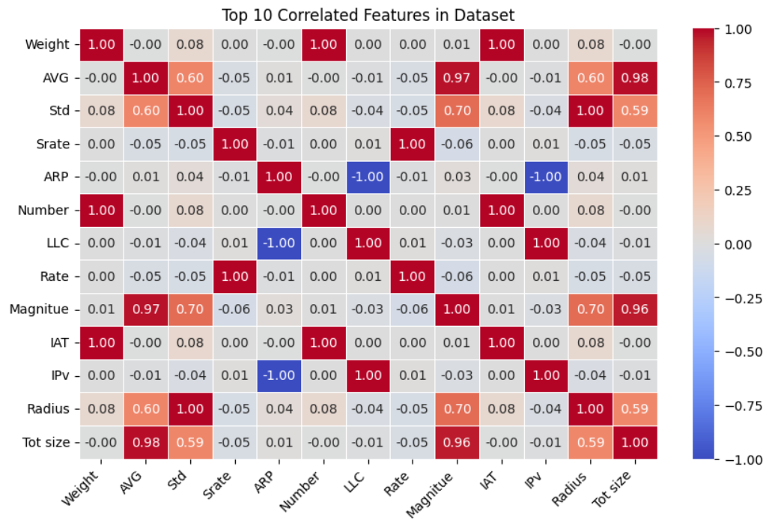
Correlation Analysis
Correlation analysis was performed to understand the relationships between different features in the dataset.

Slide 10
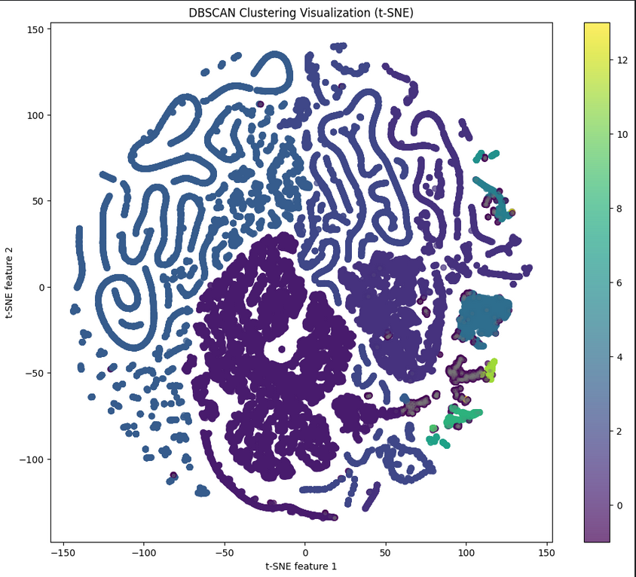
DBSCAN Clustering

Slide 11




Machine Learning Models
Multiple machine learning algorithms were applied to the preprocessed dataset to classify and predict cyber attacks. The following models were used:
Logistic Regression
Decision Trees
Random Forests
Artificial Neural Networks
A non-linear model that splits data into subsets based on input features
An ensemble method combining multiple decision trees
A linear model used for binary classification tasks
A complex model capable of capturing non-linear relationships

Slide 12
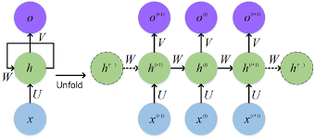
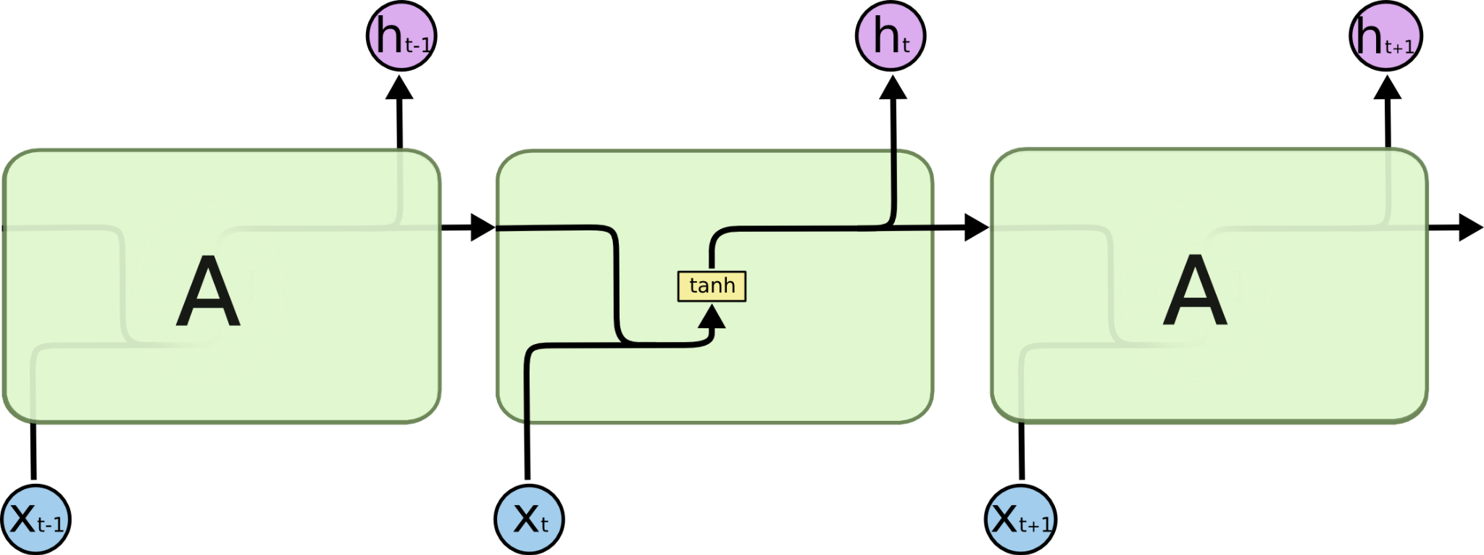

Deep Learning Models
RNN and LSTM were applied to the preprocessed dataset to classify and predict cyber attacks.
Recurrent Neural Network (RNN)
Long Short Term Memory (LSTM)
The repeating module in a standard RNN contains a single layer.
The repeating module in an LSTM contains four interacting layers.

Slide 13
Model Evaluation
Model | Accuracy | Precision | Recall | F1-Score
Logistic Regression | 0.75 | 0.70 | 0.75 | 0.67
Decision Tree | 0.81 | 0.89 | 0.81 | 0.78
Random Forest | 0.98 | 0.99 | 0.98 | 0.98
ANN | 0.96 | 0.96 | 0.96 | 0.96
RNN | 0.9349 | 0.9374 | 0.9349 | 0.932
LSTM | 0.9652 | 0.9706 | 0.9652 | 0.965

Slide 14
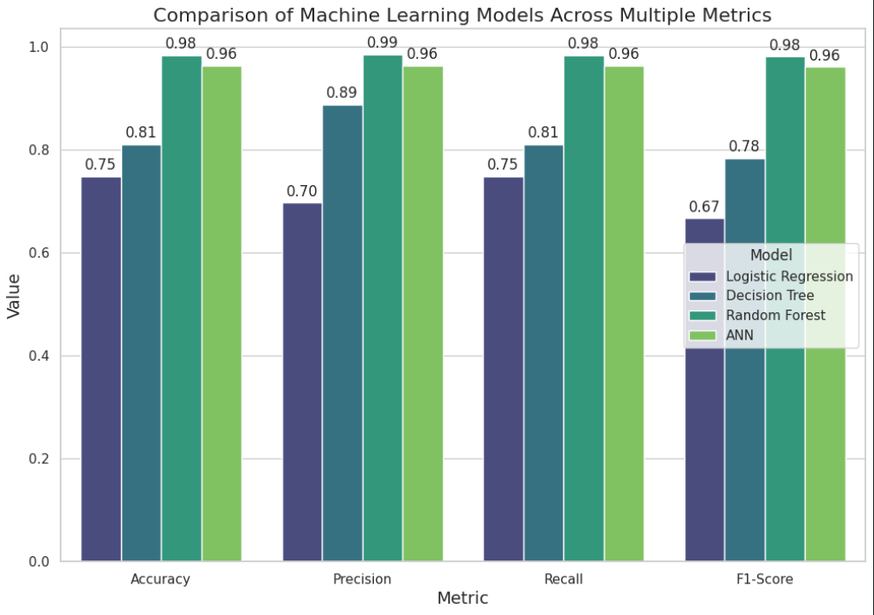
Machine Learning Models Comparison

Slide 15
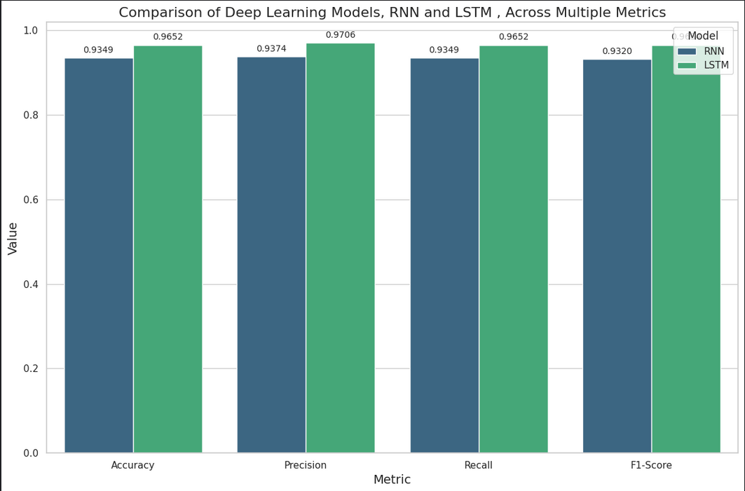
Deep Learning Models Comparison

Slide 16




Feature Importance
The Random Forest model was used to determine feature importance. The analysis revealed that certain features, such as packet size and source IP address, play a significant role in the detection of cyber attacks.
Identify Key Features
Analyze Top Features
Optimize Feature Set
Improve Model Performance
Use Random Forest to rank features by importance
Examine the most significant features for attack detection
Refine the feature set based on importance analysis
Enhance detection accuracy with optimized features

Slide 17
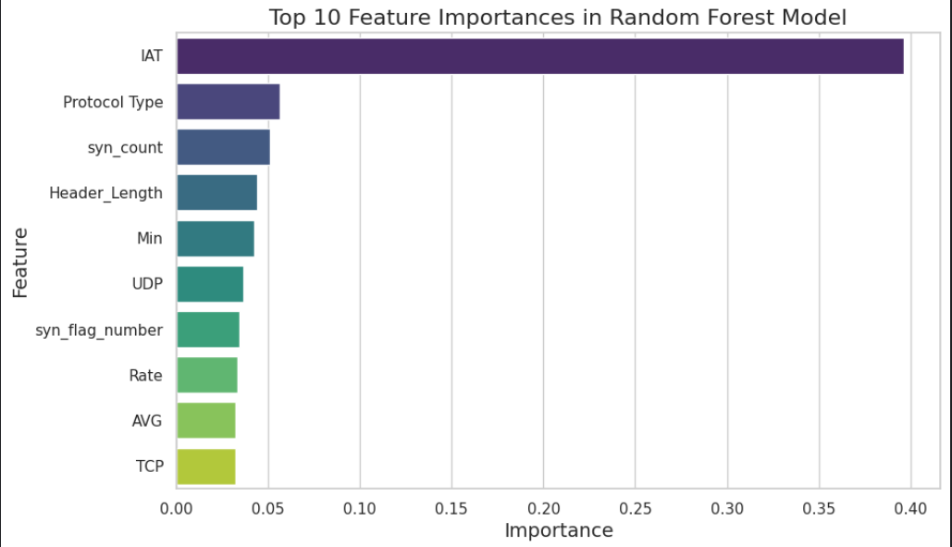
Important Features in Random Forest

Slide 18
Previous Research Comparison:
Relatively very New Dataset based on 2024
Previous Research: (Attack Vectors in
Healthcare devices) —Random Forest
Accuracy : 0.99553086
Recall: 0.89345693
Precision : 0.94831885
F1 Score: 0.90736136
Our Research: (Random Forest)
Random Forest | 0.98 | 0.99 | 0.98 | 0.98

Slide 19
Future Directions
Feature engineering and selection
Hyperparameter tuning
Ensemble methods
Deep learning architectures
Synthetic Data Generation for Class Imbalance
Transfer learning
Interpretability analysis and Explainable AI

Slide 20
Conclusion
Key Findings
Challenges
Machine learning models, particularly Random Forests and LSTM, significantly improve cyber attack detection accuracy
Dataset imbalance and the dynamic nature of cyber threats remain significant hurdles
Impact
Enhanced cybersecurity measures to protect critical infrastructure and information assets

